Slide 1
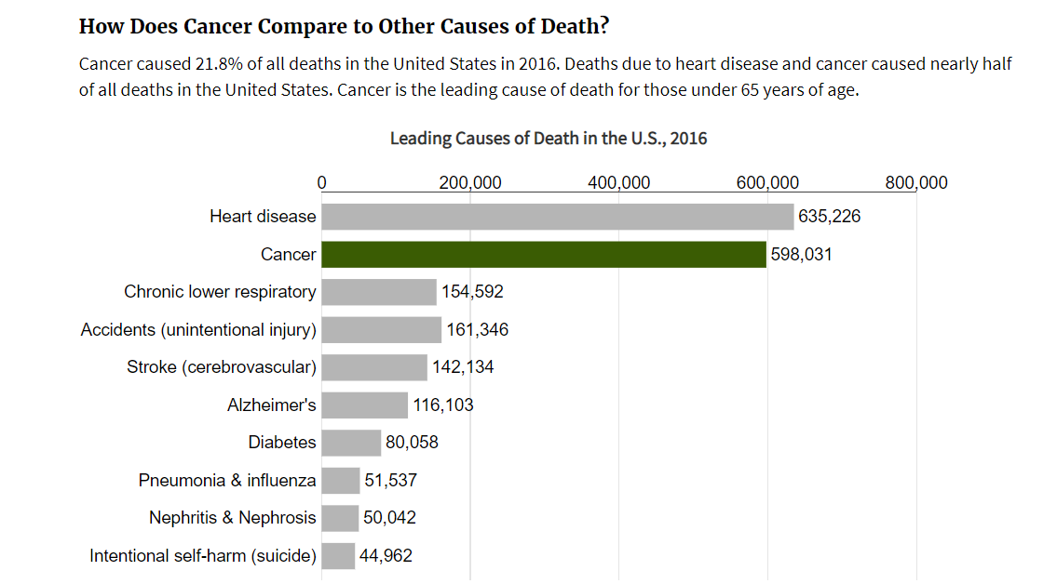
Cancer – we all hear about it all the time. Second Leading cause of death
Cool Kids

Slide 2
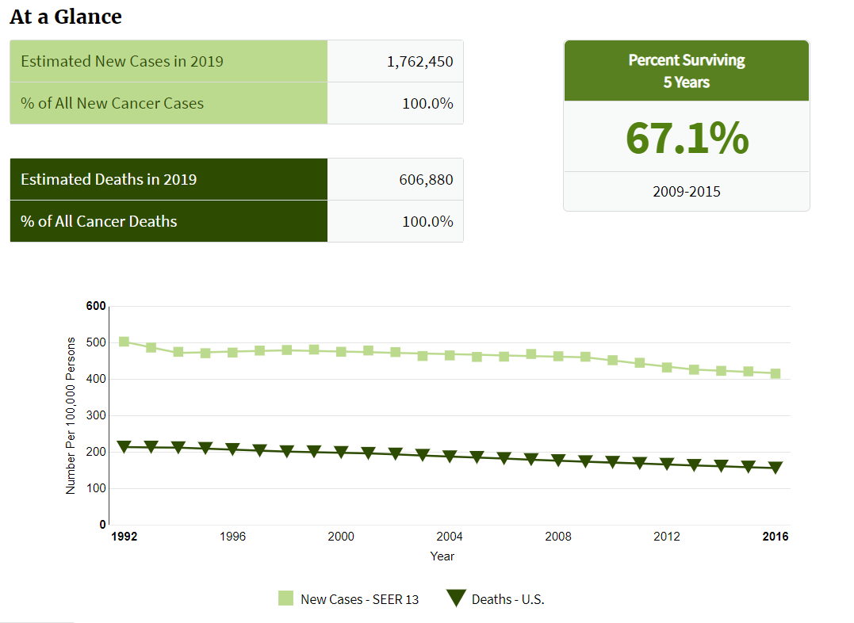
Cancer is a big deal but survival rate is good!

Slide 3
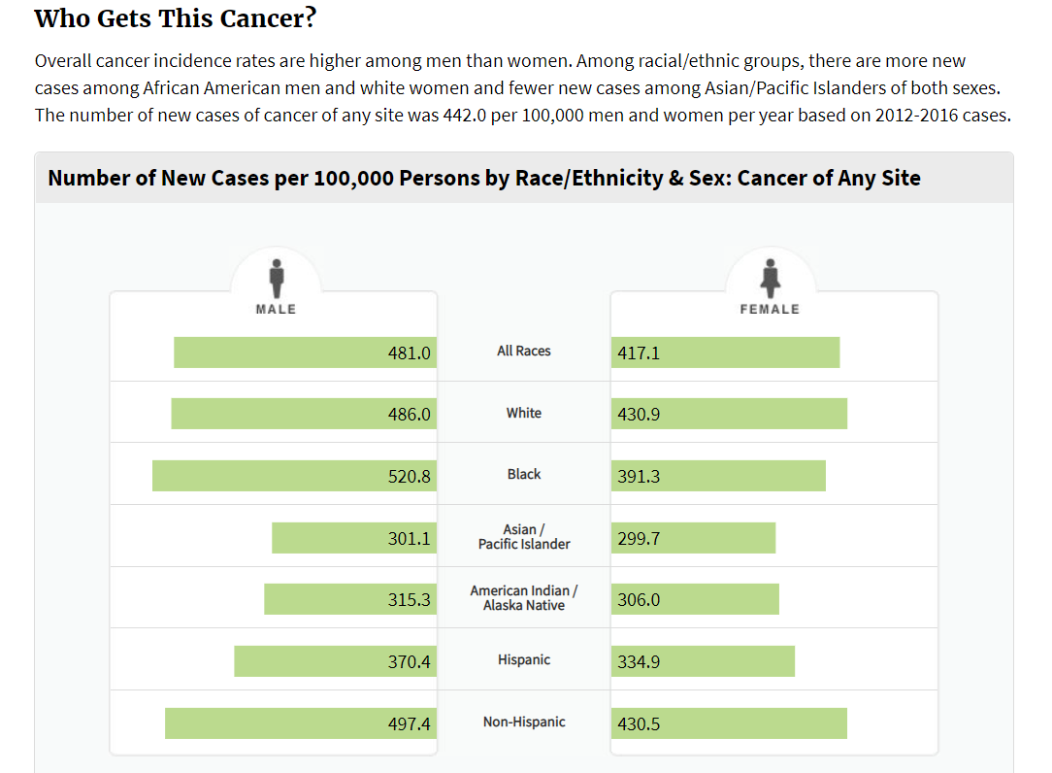
Will this impact me??

Slide 4
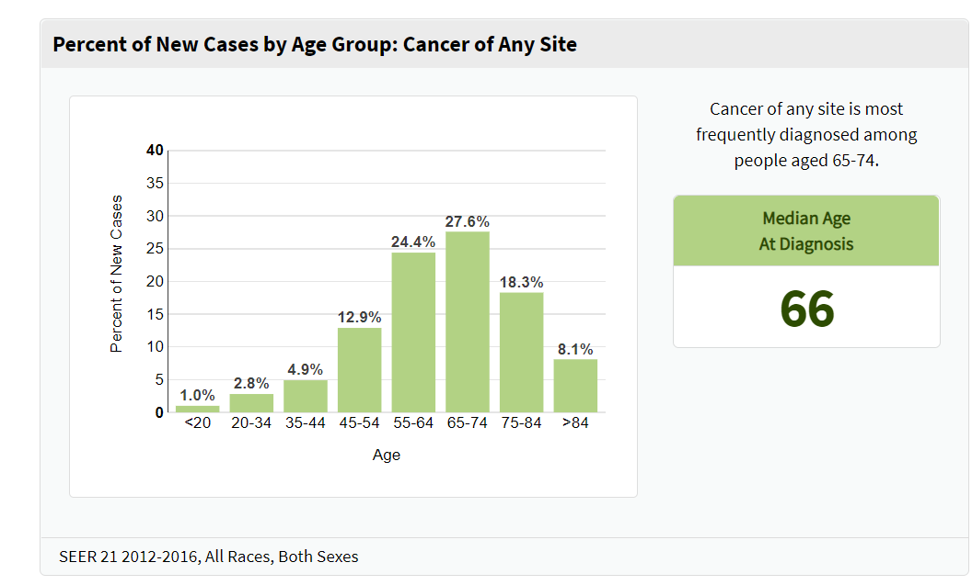
Cases by Age??

Slide 5
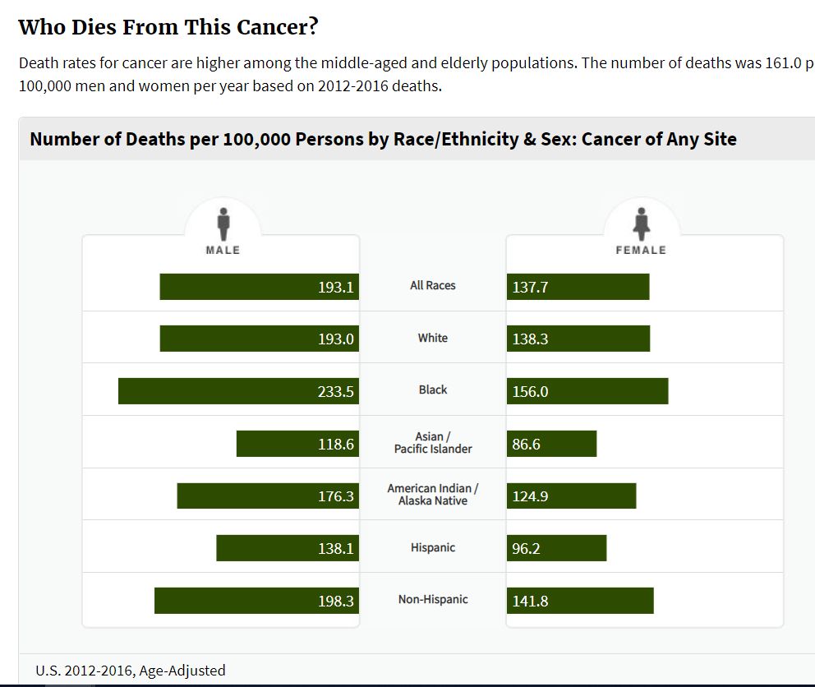
Information About Mortality Rates

Slide 6
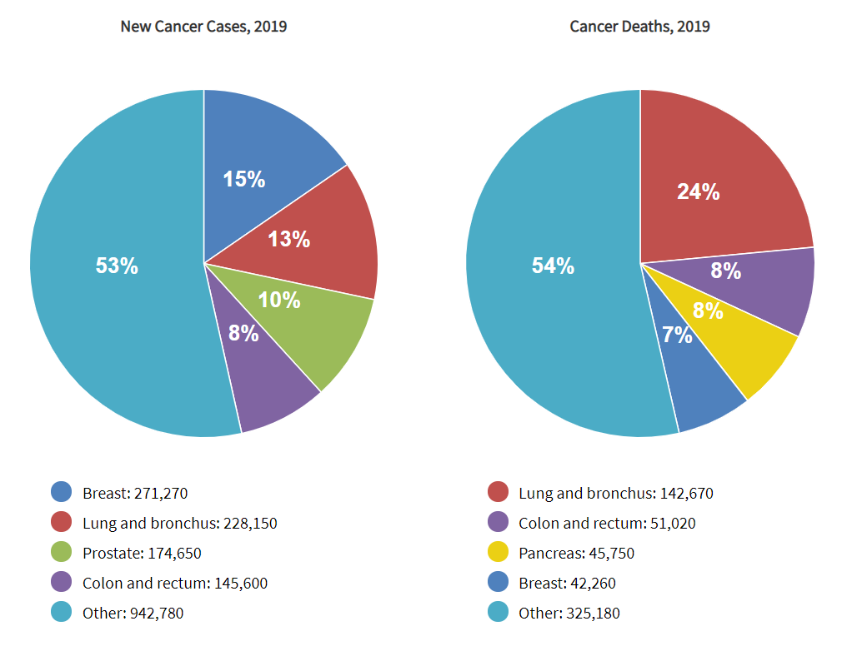
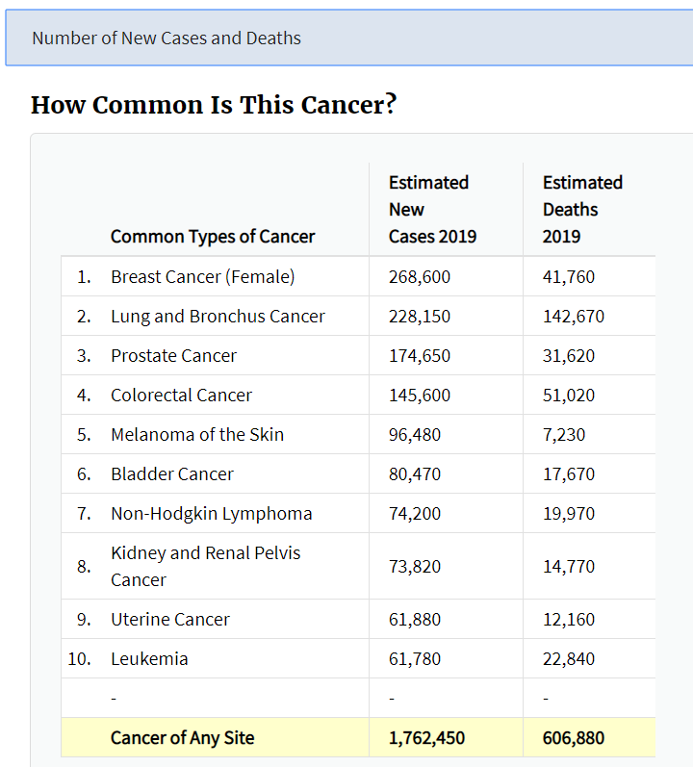
What types of cancer are the leading ones?

Slide 7
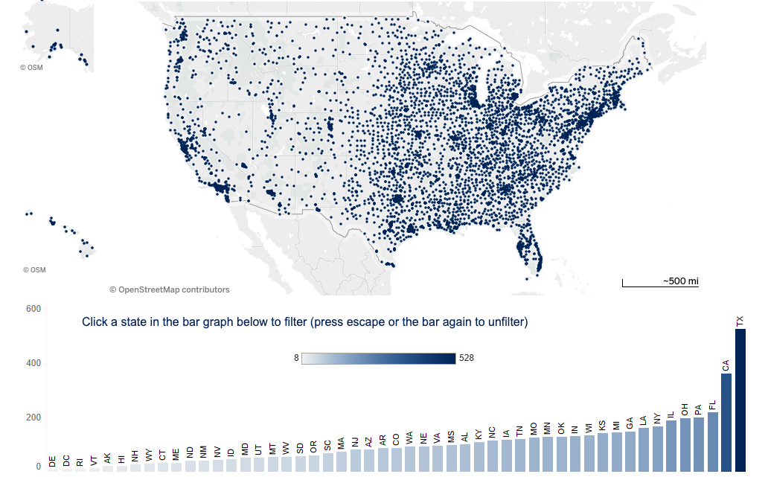
Treatment – Hospitals Across the US
Drill down to only cancer hospitals

Slide 8
Cancer Hospitals in the US with Ranking

Slide 9
Where are we going?

Slide 10
More questions?

